Slide 1
Basics of Memories

Slide 2
Lecture 45 Basic concepts of Concepts of FPGA and CPLD
Lecture by
Deepak V.

Slide 3
Objectives
At the end of this lecture, student will be able to:
Acquire the knowledge of FPGA
Acquire the knowledge of CPLD

Slide 4
Topics
FPGA
CPLD

Slide 5
FPGA AND CPLD
FPGA - Field-Programmable Gate Array
CPLD - Complex Programmable Logic Device
FPGA and CPLD is an advance PLD
Support thousands of gate where as PLD only support hundreds of gates

Slide 6
What is an FPGA?
Before the advent of programmable logic, custom logic circuits were built at the board level using standard components, or at the gate level in expensive application-specific (custom) integrated circuits
FPGA is an integrated circuit that contains many (64 to over 10,000) identical logic cells that can be viewed as standard components. Each logic cell can independently take on any one of a limited set of personalities

Slide 7
Contd..
Individual cells are interconnected by a matrix of wires and programmable switches. A user's design is implemented by specifying the simple logic function for each cell and selectively closing the switches in the interconnect matrix
Array of logic cells and interconnect form a fabric of basic building blocks for logic circuits. Complex designs are created by combining these basic blocks to create the desired circuit

Slide 8
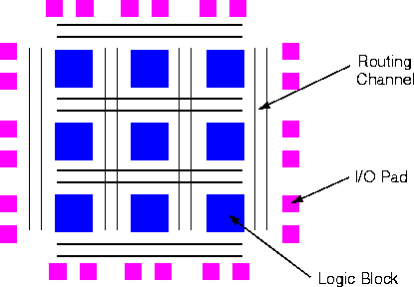
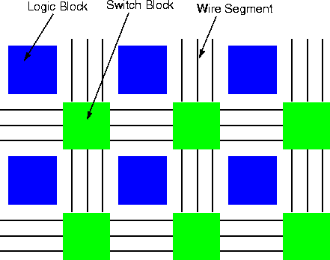
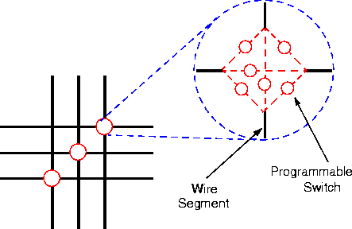
FPGA architecture

Slide 9
What does a logic cell do?
The logic cell architecture varies between different device families
Each logic cell combines a few binary inputs (typically between 3 and 10) to one or two outputs according to a Boolean logic function specified in the user program
In most families, the user also has the option of registering the combinatorial output of the cell, so that clocked logic can be easily implemented
Cell's combinatorial logic may be physically implemented as a small look-up table memory (LUT) or as a set of multiplexers and gates
LUT devices tend to be a bit more flexible and provide more inputs per cell than multiplexer cells at the expense of propagation delay

Slide 10
What does 'Field Programmable' mean?
Field Programmable means that the FPGA's function is defined by a user's program rather than by the manufacturer of the device
A typical integrated circuit performs a particular function defined at the time of manufacture. In contrast, the FPGA's function is defined by a program written by someone other than the device manufacturer
Depending on the particular device, the program is either 'burned' in permanently or semi-permanently as part of a board assembly process, or is loaded from an external memory each time the device is powered up
This user programmability gives the user access to complex integrated designs without the high engineering costs associated with application specific integrated circuits

Slide 11
How are FPGA programs created?
Individually defining the many switch connections and cell logic functions would be a daunting task
This task is handled by special software. The software translates a user's schematic diagrams or textual hardware description language code then places and routes the translated design
Most of the software packages have hooks to allow the user to influence implementation, placement and routing to obtain better performance and utilization of the device
Libraries of more complex function macros (eg. adders) further simplify the design process by providing common circuits that are already optimized for speed or area

Slide 12
FPGA
FPGA applications:-
DSP
Software-defined radio
Aerospace
Defense system
ASIC Prototyping
Medical Imaging
Computer vision
Speech Recognition
Cryptography
Bioinformatics
And others.

Slide 13
CPLD
Complexity of CPLD is between FPGA and PLD.
CPLD featured in common PLD:-
Non-volatile configuration memory – does not need an external configuration PROM.
Routing constraints. Not for large and deeply layered logic.
CPLD featured in common FPGA:-
Large number of gates available.
Can include complicated feedback path.
CPLD application:-
Address coding
High performance control logic
Complex finite state machines

Slide 14
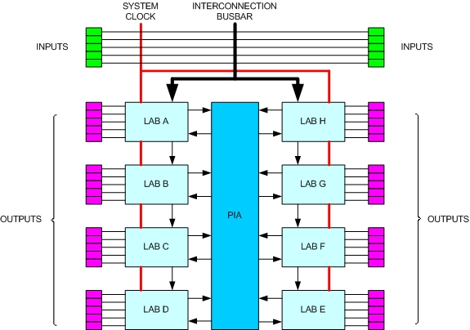
CPLD
CPLD architecture:-
LAB – Logic Array Block / uses PALs
PIA – Programmable Interconnect Array

Slide 15
Summary
FPGA and CPLD is an advance PLD
Support thousands of gate where as PLD only support hundreds of gates
FPGA is an integrated circuit that contains many (64 to over 10,000) identical logic cells that can be viewed as standard components
The logic cell architecture varies between different device families
Field Programmable means that the FPGA's function is defined by a user's program rather than by the manufacturer of the device

